Slide 1

USIHOOT
Software Atelier 3 – Group Project

Slide 2
Team
Lovnesh Bhardwaj
Catarina Carvalho Morais
Stefano Gonçalves Simao
Andrea Michele Zucchi
Alessio Cordivani
Brian Bronz

Slide 3
App Structure
Application
Bin
Model
Public
www
Index.js
css
js
Index.html
assets
Routes
Game.js
Quiz.js
Home.js
index.js
Views
app.js
ws.js

Slide 4

Website Structure
Homepage
Game Hosting
Game Joining
Quiz Creation
Playing the Game
Leaderboard
Podiums
Lobbies and Waiting Rooms

Slide 5
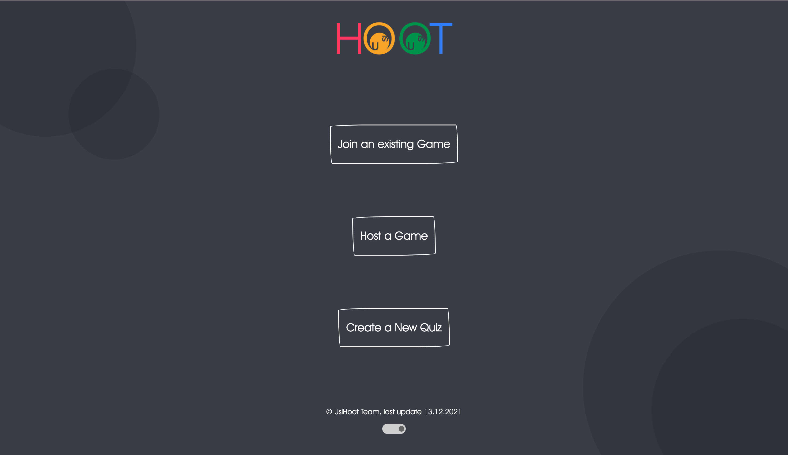
Homepage

Slide 6
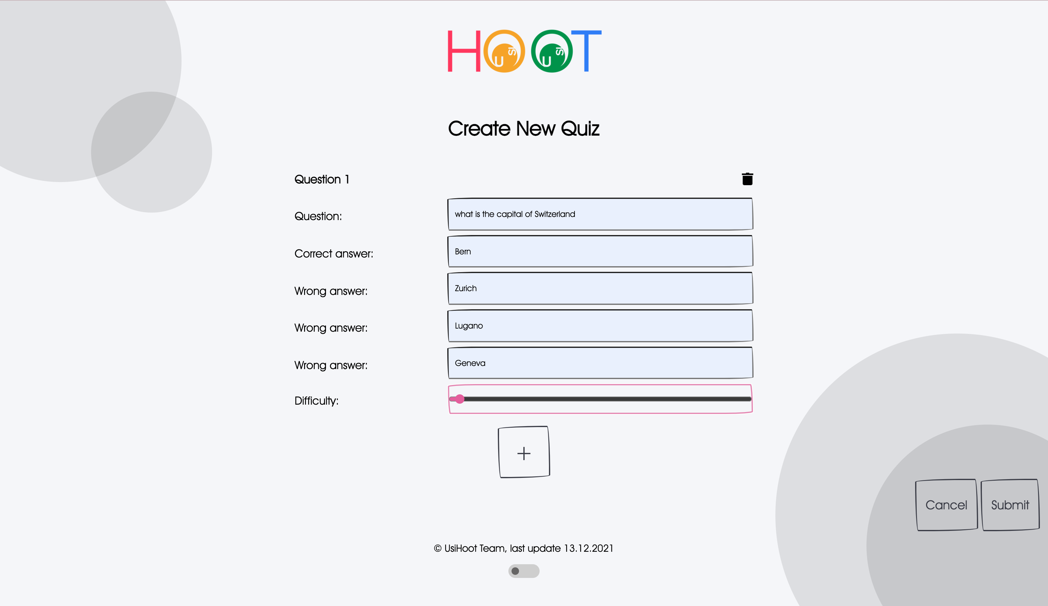
Quiz Creation

Slide 7
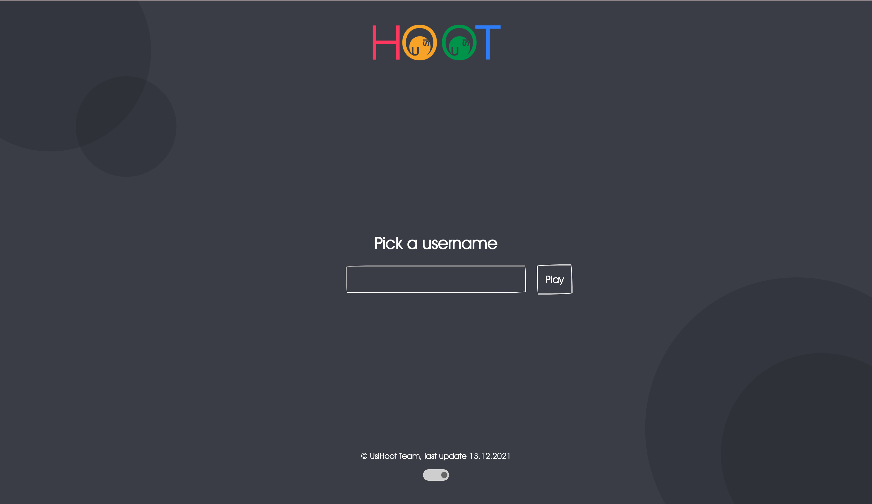
Joining a game

Slide 8

Other pages Under construction

Slide 9

Demonstration

